Slide 1
Data Preprocessing for Credit Scoring

Slide 2
Motivation
Success of the preprocessing steps is crucial to success of following steps
Garbage in, Garbage out (GIGO)
Very time consuming (80% rule)

Slide 3
Common Problems with Data
Dirty, noisy data
For example, Age= -2003
Inconsistent data
Value “0” means actual zero or missing value
Incomplete data
Income=?
Data integration and data merging problems
Amounts in Euro versus Amounts in dollar
Duplicate data
Salary versus Professional Income

Slide 4
Preprocessing Data for Credit Scoring
Considerations that will be discussed
Types of variables
Sampling
Missing values
Outlier detection and treatment

Slide 5
Types of Variables
Continuous
Defined on a continuous interval
For example: income, loan amount, ...
Discrete
Nominal
No ordering between values
For example, purpose of loan, marital status
Ordinal
Implicit ordering between values
For example, credit rating (AAA is better than AA, AA > A, …)
Binary
For example, gender

Slide 6
Sampling
Take sample of past applicants to build scoring model
Think careful about population on which the model that is going to be built using the sample, will be used
Timing of sample
How far do I go to get my sample?
Trade-off: many data versus recent data
Number of bads versus number of goods
Undersampling, oversampling may be needed (dependent on classification algorithm, cf. infra)

Slide 7
Sampling
Sample taken must be from a normal business period, to get as accurate a picture as possible of the target population
Make sure performance window is long enough to stabilize bad rate (e.g. 18 months)
Example sampling problems
Application scoring: reject inference
Behavioural scoring: seasonality depending upon the choice of the observation point

Slide 8
Missing Values - Categories
Missing completely at random (MCAR)
Reason data is missing is unrelated to other data
E.g. applicant did not see questions on back of form
Missing at random (MAR)
Reason missing can be inferred from other data
E.g. missing value of ‘profession’ where age <10
Missing not at random (MNAR)
Underlying reason for missing data
E.g. applicant does not want to disclose because embarrassed
Structurally missing data
Data missing for a logical reason
E.g. oldest credit line is missing because never had credit

Slide 9
Missing Values - Options
Keep
That a variable is missing can be important information!
Encode variable in a special way
e.g. separate category during coarse classification
Delete
When too many values are missing, removing the variable or observation might be appropriate
Horizontally versus vertically missing values
Replace
Estimate missing value using imputation procedures

Slide 10
Imputation Procedures for Missing Values
For continuous attributes
Replace with median/mean
Median more robust to outliers
Replace with median/mean of all instances of the same class
For ordinal/nominal attributes
Replace with modal value
i.e. most frequent category
Advanced schemes
Not recommended
Notes:
Advanced schemes include
Regression or tree-based imputation
Predict missing value using other variables
Not recommended!

Slide 11
Outliers
Can result from recording/data entry errors or noise
Types of outliers
Valid observation: e.g. salary of boss, ratio variables
Invalid observation: age =-2003
Detection versus treatment

Slide 12
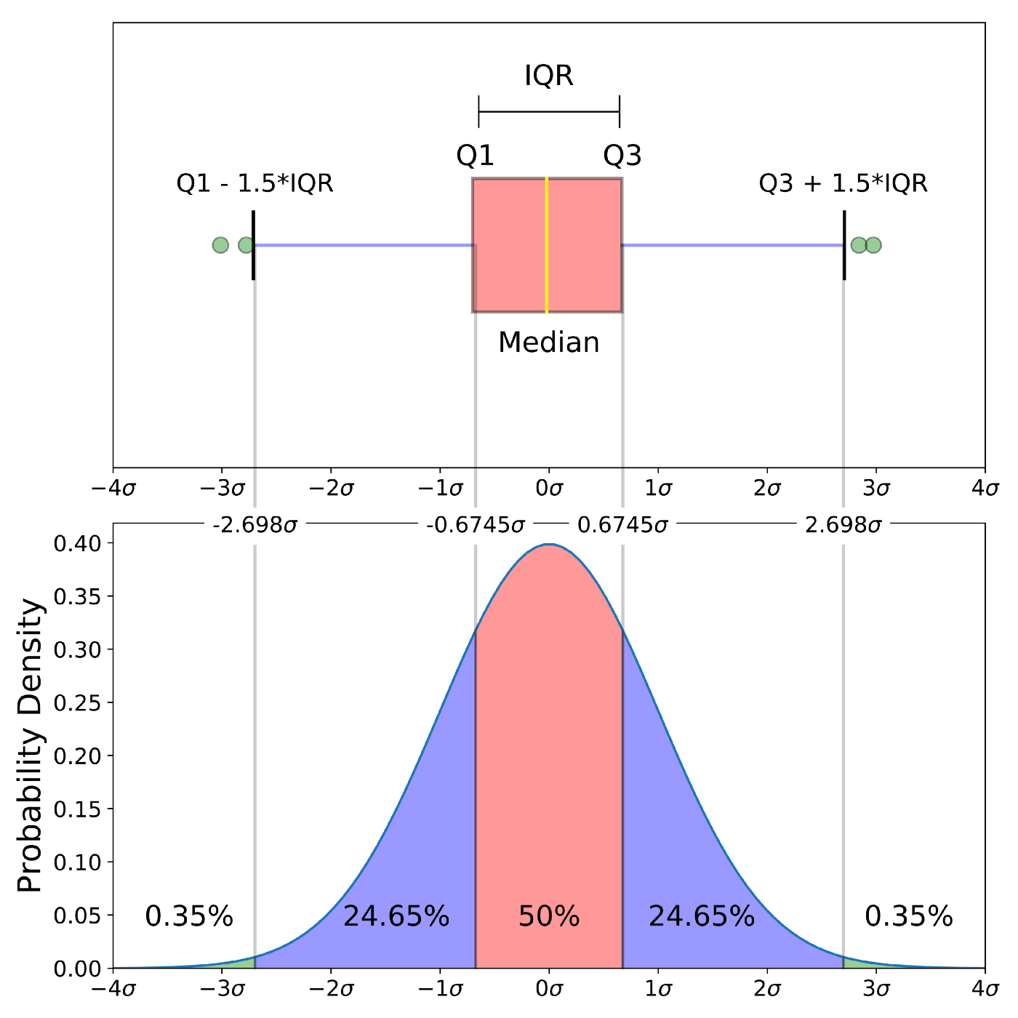
Univariate Outlier Detection Methods
Box plots and histograms provide a visual representations
https://towardsdatascience.com/understanding-boxplots-5e2df7bcbd51

Slide 13
Univariate Outlier Detection Methods
z-score
Measures how many standard deviations an observation is away from the mean
m is the mean of variable x_{i} and s its standard deviation
Outliers are variables having |z_{i}| > 3 (or 2.5)
Note: mean of z-scores is 0, standard deviation is 1

Slide 14
Treatment of Outliers
For invalid outliers:
E.g. age=300 years
Treat as missing value (keep, delete, replace)
For valid outliers:
Truncation based on z-scores:
Replace all xvariable values having z-scores of > 3 by the mean + 3 times the standard deviation
Replace all variable values having z-scores of < -3 by the mean -3 times the standard deviation
Notes:
Alternatively can truncate based on IQR (more robust than z-scores)
Truncate to M±3s, with M=median and s=IQR/(2 x 0.6745)
See Van Gestel, Baesens et al., 2007

